Slide 1
The Green Tax Shift concept and the economics of climate change
Source: www.OzPolitic.com

Slide 2

What I’m going to talk about
Statement of economic consensus
Low hanging fruit
The emissions reduction multiplier
High hanging fruit
Perfect competition- the ideal free market
Carbon Taxes
Green Tax Shift
Implications for international negotiations
Implications for price stability
Bonus material:
Other green taxes and economic mechanisms
Sources of conflicting economic advice

Slide 3

Statement of economic consensus
https://en.wikipedia.org/wiki/Economists%27_Statement_on_Climate_Change
Economics studies have found that there are many potential policies to reduce greenhouse-gas emissions for which the total benefits outweigh the total costs. For the United States in particular, sound economic analysis shows that there are policy options that would slow climate change without harming American living standards, and these measures may in fact improve U.S. productivity in the longer run.
The United States and other nations can most efficiently implement their climate policies through market mechanisms, such as carbon taxes or the auction of emissions permits. The revenues generated from such policies can effectively be used to reduce the deficit or to lower existing taxes.
Signed by more than 2600 economists in 1997

Slide 4



Low hanging fruit
When we buy an item, we consider how much we desire it vs how reluctant we are to let go of our hard-earned cash
Some people also consider the ecological footprint of the product (but not very well)
Light bulbs and apple pies
Large number of ‘invisible’ ways to reduce GHG emissions for a very low price – disconnect between what people actually want and GHG emissions.
Economics as ‘the hopeful science’

Slide 5

The emissions reduction multiplier
If you can:
  Produce electricity with half the GHG emissions
  Produce a material with half the electricity
  Produce an item with half as much material
  Buy half as many items
  Recycle half the items you buy (assume no significant emissions)
You reduce your emissions by 97% with little impact on quality of life.

Slide 6

High hanging fruit
Renewable energy sources are very expensive and should not be implemented until we have exhausted cheaper options. Those cheaper options can be done, and the more expensive options may not be necessary.
Reducing consumption is generally much cheaper, because no-one actually wants to emit GHG’s (or drink petrol, or eat electricity)
People want things like light, transport, comfort, entertainment, which can be obtained in a variety of ways.
Government cannot make these decisions for us, but are expected to “do something” (anything but a tax…)

Slide 7


Perfect competition – the ideal free market
Microeconomics: The invisible (God-like) hand of the free market, achieving an ideal outcome through the interaction of supply and demand under certain conditions (assumptions), called perfect competition…
  No (negative) externalities
  Zero transaction costs
  Well defined property rights
  Many buyers and sellers (no monopolies, no-one has the market power to set the price, no economies of scale or network effects, laws against anti-competitive behaviour)
  Informed consumers and producers
  Homogenous products (commodities – no ‘premium’ products)
  No barriers to entry and exit
  Mobile means of production
  Profit maximising sellers and rational buyers
Justification for government intervention

Slide 8

Carbon Taxes
Carbon taxes increase the price of every item for sale according to it’s carbon footprint.
They are intended to be avoided (by lowering our carbon footprint).
Internalises the negative externality, gets rid of the transaction cost, invents a property right (sort of)
People inevitably choose the cheapest or least disruptive options for reducing GHG emissions, in a rational timeframe (low hanging fruit).
Increase the tax to make more expensive options happen (if necessary).

Slide 9

Green Tax Shift
Where does the money go
  Reducing other taxes.
  Funding GHG capturing (at the same price)
  NOT funding renewables
Ensures that the real cost of the initial changes society makes to reduce GHG emissions are close to zero.
Avoids confounding the GTS with the politics of big vs small government.

Slide 10

Implications for international negotiations
Cap and trade creates a literal third currency that (unrealistically/undeservedly) demands trust in foreign governments.
They make large transfers of this currency between countries inevitable, as well as payoffs to poorer countries.
Carbon taxes achieve the same thing, but keep the money in the country.

Slide 11
Implications for price stability
Taxes control the price and let the market determine the quantity ‘traded’, whereas trading schemes fix the quantity and let the market determine price.
People invest to reduce GHG emissions based on the price of emissions, but do not care what the total emissions are.
Taxes provide a steady predictable price (return on investment) whereas cap and trade schemes cause unpredictable fluctuations in price (risky investments)

Slide 12
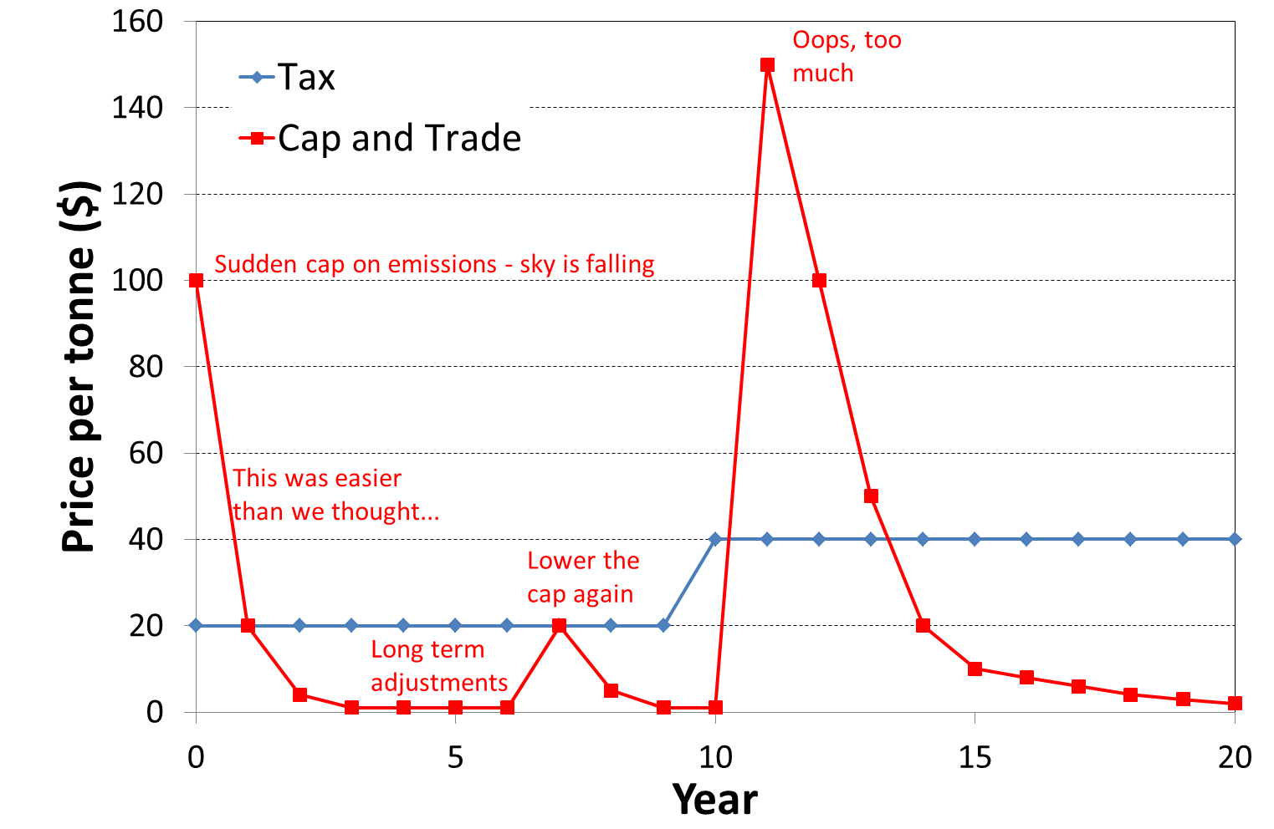
Implications for price stability

Slide 13
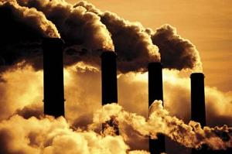
More information
http://www.ozpolitic.com/green-tax-shift/green-tax-shift.html

Slide 14

Other green taxes and economic mechanisms
Price of water should reflect marginal cost of supply (dams), the value we place on dam-free rivers, GHG emissions from cement and sediment, and implications for fisheries and scarcity in a drought (watering cans = communism).
Price of petrol should reflect cost of supplying it, building and maintaining roads (petrol consumption is a convenient proxy measure of road wear and space consumed), and emissions tax.
Price of steak should reflect minimum known net GHG impact of methane emissions from cattle.
And GST on top of these taxes.
Price of electricity should be variable.

Slide 15

Sources of conflicting economic advice
Economists are asked to predict the future
Economists (or people pretending to be economists) confuse positive and normative economics.
  Positive: what is true, what the consequences of government policy will be
  Normative: what is good, what is fair, what the government should do (regardless of consequence)
Economics is often counter-intuitive
  The road to hell is paved with good intentions
  Need more economics in school

